Slide 1

NewsBot Intelligence System 2.0
Jeffery Dirden
ITAI 2373

Slide 2
Hello everyone. My name is Jeffery Dirden, and today I’ll be presenting our NLP project called the NewsBot Intelligence System. This system is designed to analyze and extract insights from real-world news content using powerful natural language processing techniques. My teammate, Williane Yarro, and I collaborated to build a pipeline that includes data preprocessing, text vectorization, syntactic and semantic analysis, and a simple front-end interface using Gradio.

Slide 3
Understanding the Objective
The goal of our project was to develop a system that can analyze news articles and extract linguistic and semantic information. This included tokenizing text, performing part-of-speech tagging, named entity recognition, and applying syntactic patterns to capture the structure of the content. For this, we used a combination of NLTK, SpaCy, Gensim, and Scikit-learn. The front end was built using Gradio to make the system interactive.

Slide 4
BBC News Dataset
We used the publicly available BBC News dataset which contains articles across 5 categories: business, entertainment, politics, sport, and tech.
Each article is labeled and contains a body of text. Here’s a quick look at how we loaded and cleaned the dataset.
df = pd.read_csv("bbc_news.csv")
df.dropna(inplace=True)
df['content'] = df[‘content'].astype(str)

Slide 5
Data Preprocessing and Cleaning
We tokenized the text and removed English stopwords using NLTK. We also created a dictionary and corpus using Gensim to prepare for future topic modeling or semantic analysis if needed.
from nltk.corpus import stopwords
stop_words = set(stopwords.words('english'))
texts = [
[word.lower() for word in str(doc).split() if word.lower() not in stop_words]
for doc in df['content']
]

Slide 6
TF-IDF: Measuring Word Importance
We used TF-IDF to measure how important a word is in a document relative to the whole corpus. This helps us understand which terms are more meaningful in context. The TF-IDF output was later used to visualize feature importance and keyword distribution.
from sklearn.feature_extraction.text import TfidfVectorizer
vectorizer = TfidfVectorizer(stop_words='english', max_features=5000)
X_tfidf = vectorizer.fit_transform(df['content'])

Slide 7
Part-of-Speech Tagging and Grammar Patterns
We used SpaCy to extract linguistic structure through POS tagging and dependency parsing. This helps us identify patterns like Noun Phrases, Verb Phrases, or Subject-Verb-Object relationships. From this, we could extract noun chunks and understand the grammatical roles of words.
import spacy
nlp = spacy.load('en_core_web_sm')
doc = nlp("The prime minister addressed the nation about the economy.")
for token in doc:
print(token.text, token.pos_, token.dep_)

Slide 8
Named Entity Recognition (NER)
We used SpaCy's NER pipeline to extract names of organizations, people, locations, and dates. This adds a layer of semantic understanding. This allowed us to identify key entities in each article, like political figures, companies, or events.
for ent in doc.ents:
print(ent.text, ent.label_)

Slide 9
Interactive Interface with Gradio
To make our analysis more user-friendly, we created a Gradio-based interface. Users can input a news article and see real-time NLP outputs like POS tags, named entities, and syntactic analysis. This makes the system accessible to journalists, researchers, or students who want to analyze text without running code.
import gradio as gr
def analyze_text(text):
doc = nlp(text)
return [(token.text, token.pos_, token.dep_) for token in doc]
iface = gr.Interface(fn=analyze_text, inputs="text", outputs="json")
iface.launch()

Slide 10
Collaboration and Roles
I took the lead on the technical architecture, data analysis, and coding, while my teammate Williane contributed in the early implementation stages and helped with student-related tasks like documentation, testing, and understanding the theory behind NLP methods.
We worked together to reflect on our learning and ensure the final system was well-rounded and easy to use.

Slide 11
What We Learned
This project deepened our understanding of natural language processing pipelines and real-world application of tools like SpaCy, NLTK, and Gradio.
I personally learned how to go from raw data to an operational tool, combining backend processing with frontend usability.
Williane also gained a solid understanding of NLP workflows and how syntax and semantics work in machine understanding of language.

Slide 12
Next Steps and Improvements
In future versions, I’d like to aim to integrate sentiment analysis, topic modeling with LDA, and possibly use a transformer model like BERT for deeper context understanding, & also integrate advanced API’s.
I’d also like to expand the front end with more visualizations like word clouds, entity graphs, and summaries. I’ve grown very familiar with Google Colab, but I’m looking forward to learning, and working with more advanced platforms once I upgrade my computational power.

Slide 13
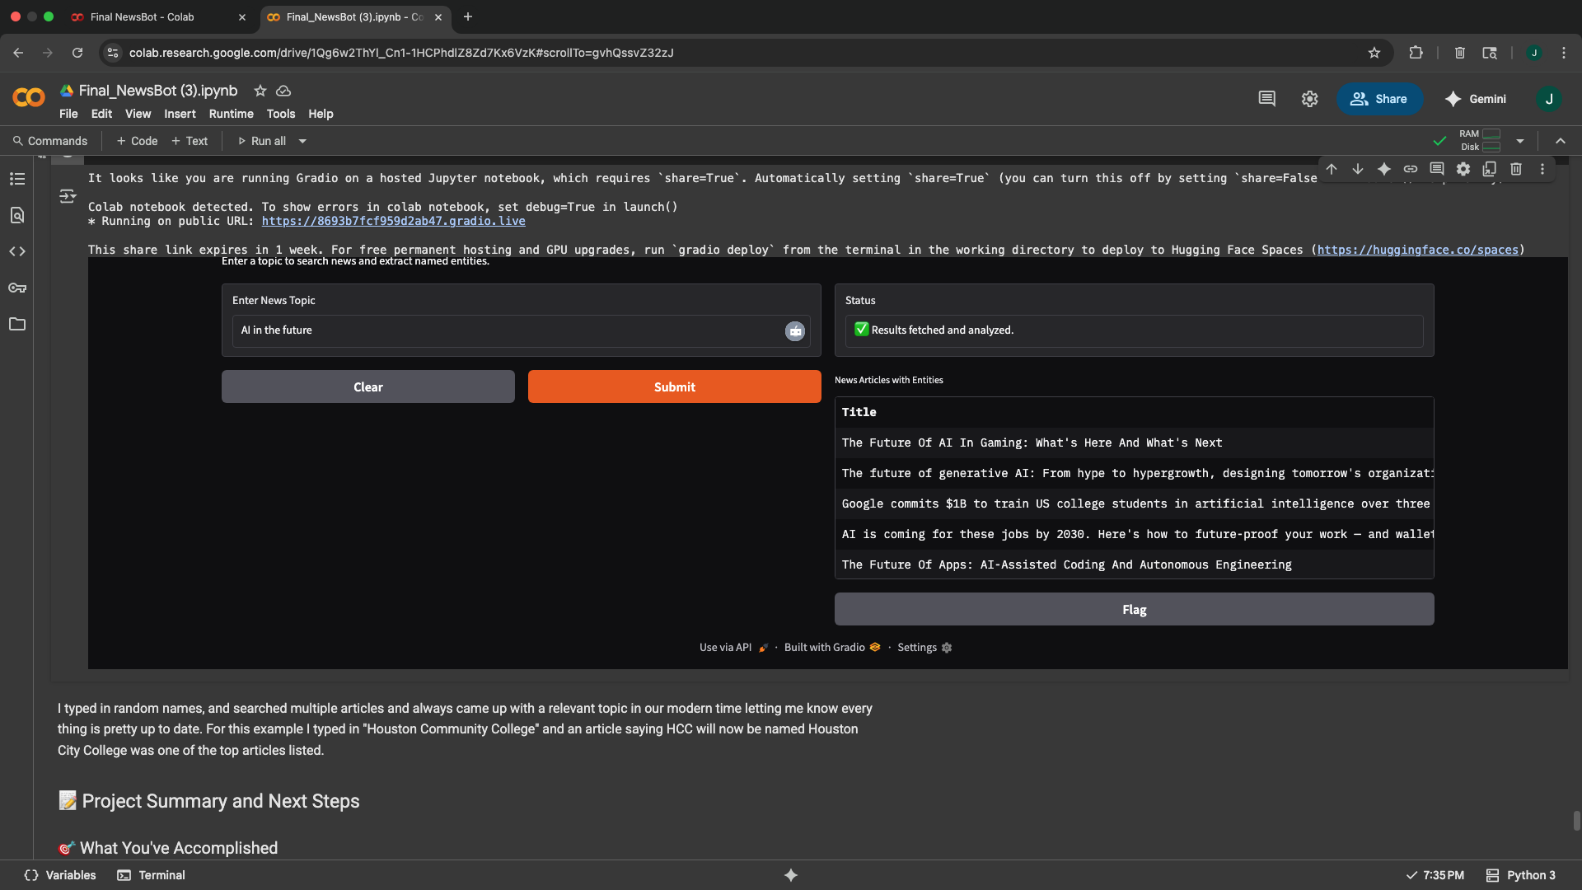
Live Demo of NewsBot
For this example I searched AI in the future.

Slide 14
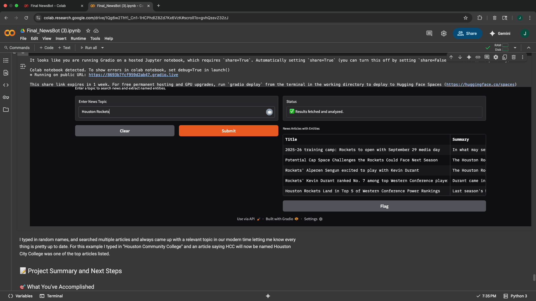
Live Demo of NewsBot
For this example I searched Houston Rockets.

Slide 15
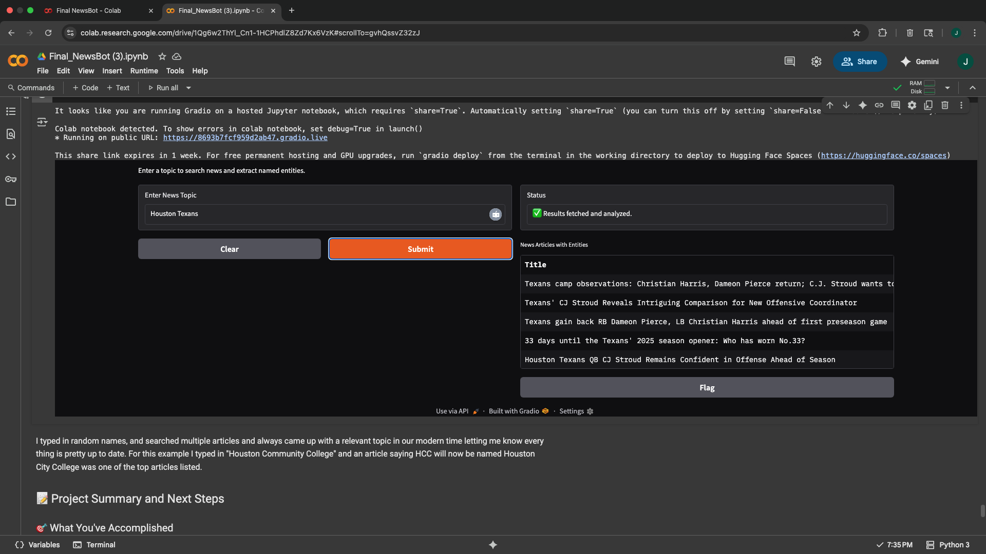
Live Demo of NewsBot
For this example I searched Houston Texans.

Slide 16

Live Demo of NewsBot
For this example I searched Houston Community College.

Slide 17


